Slide 1
The Music Database
The music database stores details of a personal music library, and could be used to manage your MP3, CD, or vinyl collection. Because this database is for a personal collection, it’s relatively simple and stores only the relationships between artists, albums, and tracks. It ignores the requirements of many music genres, making it most useful for storing popular music and less useful for storing jazz or classical music.

Slide 2
We first draw up a clear list of requirements for our database:
The collection consists of albums.
An album is made by exactly one artist.
An artist makes one or more albums.
An album contains one or more tracks
Artists, albums, and tracks each have a name.
Each track is on exactly one album.
Each track has a time length, measured in seconds.
When a track is played, the date and time the playback began (to the nearest second) should be recorded; this is used for reporting when a track was last played, as well as the number of times music by an artist, from an album, or a track has been played.

Slide 3
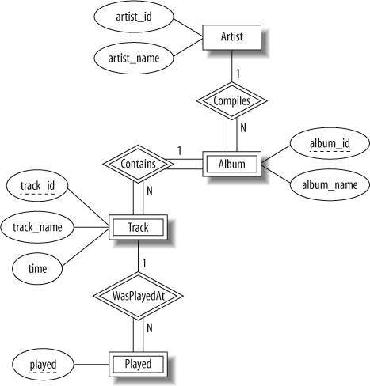

Slide 4
It consists of only one-to-many relationships: one artist can make many albums, one album can contain many tracks, and one track can be played many times.
Conversely, each play is associated with one track, a track is on one album, and an album is by one artist.
The attributes are straightforward: artists, albums, and tracks have names, as well as identifiers to uniquely identify each entity.
The track entity has a time attribute to store the duration, and the played entity has a timestamp to store when the track was played.

Slide 5
The only strong entity in the database is Artist, which has an artist_id attribute that uniquely identifies it.
Each Album entity is uniquely identified by its album_id combined with the artist_id of the corresponding Artist entity.
A Track entity is similarly uniquely identified by its track_id combined with the related album_id and artist_id attributes.
The Played entity is uniquely identified by a combination of its played time, and the related track_id, album_id, and artist_id attributes.

Slide 6
The University Database
The university database stores details about university students, courses, the semester a student took a particular course (and his mark and grade if he completed it), and what degree program each student is enrolled in. The database is a long way from one that’d be suitable for a large tertiary institution, but it does illustrate relationships that are interesting to query, and it’s easy to relate to when you’re learning SQL. We explain the requirements next and discuss their shortcomings at the end of this section.

Slide 7
Consider the following requirements list:
The university offers one or more programs.
A program is made up of one or more courses.
A student must enroll in a program.
A student takes the courses that are part of her program.
A program has a name, a program identifier, the total credit points required to graduate, and the year it commenced.
A course has a name, a course identifier, a credit point value, and the year it commenced.
Students have one or more given names, a surname, a student identifier, a date of birth, and the year they first enrolled. We can treat all given names as a single object—for example, “John Paul.”
When a student takes a course, the year and semester he attempted it are recorded. When he finishes the course, a grade (such as A or B) and a mark (such as 60 percent) are recorded.
Each course in a program is sequenced into a year (for example, year 1) and a semester (for example, semester 1).

Slide 8
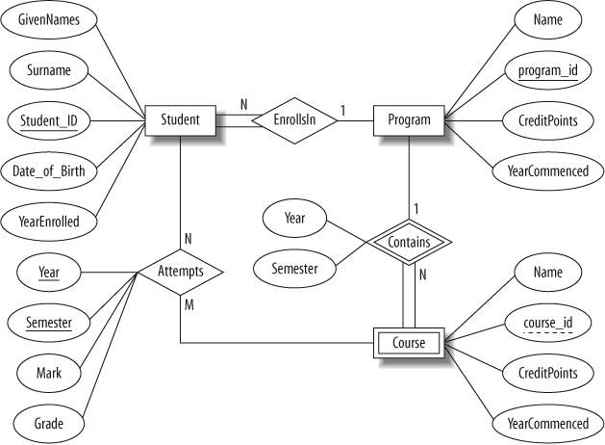

Slide 9
In our design:
Student is a strong entity, with an identifier, student_id, created to be the primary key used to distinguish between students (remember, we could have several students with the same name).
Program is a strong entity, with the identifier program_id as the primary key used to distinguish between programs.
Each student must be enrolled in a program, so the Student entity participates totally in the many-to-one EnrollsIn relationship with Program. A program can exist without having any enrolled students, so it participates partially in this relationship.
A Course has meaning only in the context of a Program, so it’s a weak entity, with course_id as a weak key. This means that a Course is uniquely identified using its course_id and the program_id of its owning program.
As a weak entity, Course participates totally in the many-to-one identifying relationship with its owning Program. This relationship has Year and Semester attributes that identify its sequence position.
Student and Course are related through the many-to-many Attempts relationships; a course can exist without a student, and a student can be enrolled without attempting any courses, so the participation is not total.
When a student attempts a course, there are attributes to capture the Year and Semester, and the Mark and Grade.

Slide 10
The Flight Database
The flight database stores details about an airline’s fleet, flights, and seat bookings. Again, it’s a hugely simplified version of what a real airline would use, but the principles are the same.

Slide 12
Consider the following requirements list:
The airline has one or more airplanes.
An airplane has a model number, a unique registration number, and the capacity to take one or more passengers.
An airplane flight has a unique flight number, a departure airport, a destination airport, a departure date and time, and an arrival date and time.
Each flight is carried out by a single airplane.
A passenger has given names, a surname, and a unique email address.
A passenger can book a seat on a flight.

Slide 13
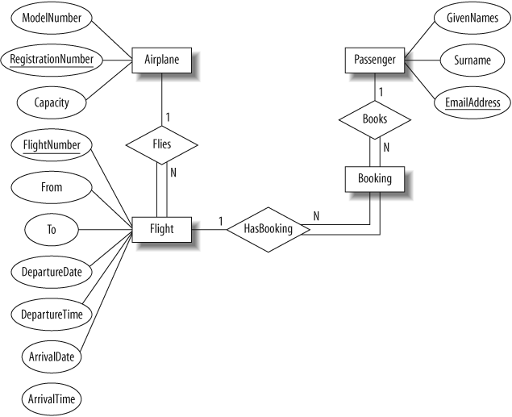

Slide 14
An Airplane is uniquely identified by its RegistrationNumber, so we use this as the primary key.
A Flight is uniquely identified by its FlightNumber, so we use the flight number as the primary key. The departure and destination airports are captured in the From and To attributes, and we have separate attributes for the departure and arrival date and time.
Because no two passengers will share an email address, we can use the EmailAddress as the primary key for the Passenger entity.
An airplane can be involved in any number of flights, while each flight uses exactly one airplane, so the Flies relationship between the Airplane and Flight relationships has cardinality 1:N; because a flight cannot exist without an airplane, the Flight entity participates totally in this relationship.

Slide 15
A passenger can book any number of flights, while a flight can be booked by any number of passengers. As discussed earlier in Intermediate Entities,” we could specify an M:N Books relationship between the Passenger and Flight relationship, but considering the issue more carefully shows that there is a hidden entity here: the booking itself. We capture this by creating the intermediate entity Booking and 1:N relationships between it and the Passenger and Flight entities. Identifying such entities allows us to get a better picture of the requirements.

Slide 16
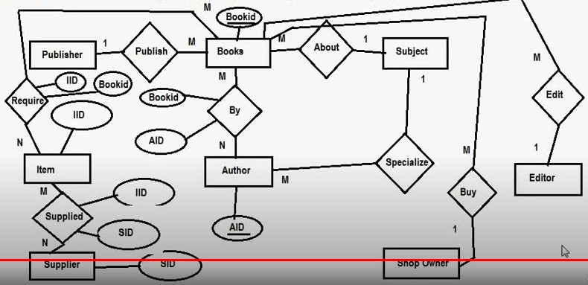

Slide 17
A publishing company produces books on various subjects.
The books are written by authors who specialize in one particular subject.
The company employs editors who not necessarily being specialists in a particular area, each take
sole responsibility for editing one or more book publications.
Every book require some items for publication.
These items are supplied by suppliers.
One supplier can supply many items.
Shop owners buys books from the publisher.
Shop owner can buy many books but one book can be bought by one shop owner only.
Books are uniquely identified by Bookid.

Slide 18
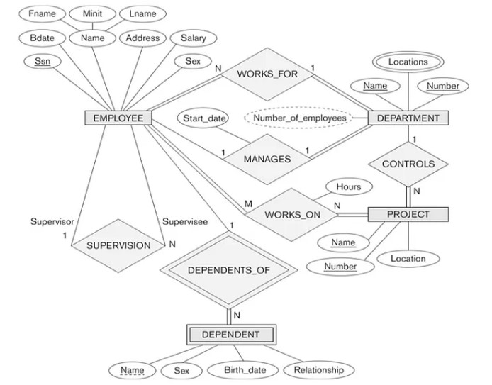
ER Diagram to Relational Mapping

Slide 19
Step 1:
Figure out all the regular/strong entity from the diagram and then create a corresponding relation(table) that includes all the simple attributes.
Choose one of the attributes as a primary key. If composite, the simple attributes together form the primary key.
For the given ER-Diagram we have Employee, Department and Project as strong/regular entity, as they are enclosed in single rectangle.

Slide 20
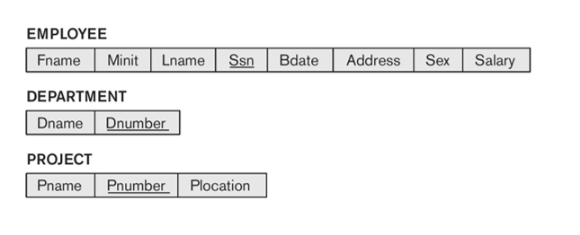

Slide 21
Step 2:
Figure out the weak entity types from the diagram and create a corresponding relation(table) that includes all its simple attributes.
Add as foreign key all of the primary key attributes in the entity corresponding to the owner entity.
The primary key is a combination of all the primary key attributes from the owner and the primary key of the weak entity.
For the given ER-Diagram we have Dependent as a weak entity, as it is enclosed in a double rectangle that is indicative of an entity being weak.
The Dependent relation(table) is created.

Slide 22
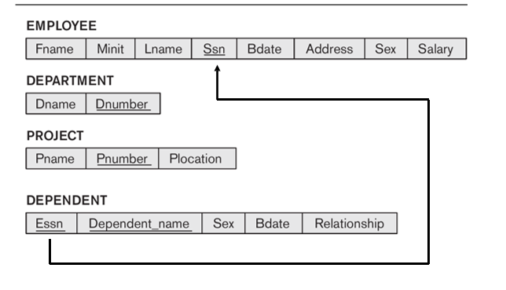

Slide 23
Step 3:
Now we need to figure out the entities from ER diagram for which there exists a 1-to-1 relationship.
The entities for which there exists a 1-to-1 relationship, choose one relation(table) as S, the other as T.
Better if S has total participation (reduces the number of NULL values).
Then we need to add to S all the simple attributes of the relationship if there exists any.
After that, we add as a foreign key in S the primary key attributes of T.
For the given ER-Diagram there exists a 1-to-1 relationship between Employee and Department entity.
Here Department has total participation therefore consider it as relation S and Employee as relation T.
The 1-to-1 mapping between Employee and Department is depicted

Slide 24
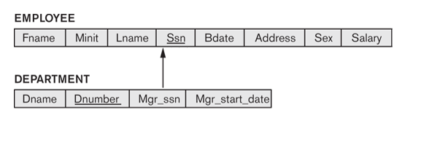

Slide 25
Step 4:
Now we need to figure out the entities from ER diagram for which there exists a 1-to-N relationship.
The entities for which there exists a 1-to-N relationship, choose a relation as S as the type at N-side of relationship and other as T.
Then we add as a foreign key to S all of the primary key attributes of T.
In the given ER diagram there are two 1-to-N relationships that exists between Employee-Department and Employee-Dependent entity.
The 1-to-N mapping between Employee-Department and Employee-Dependent is depicted

Slide 26
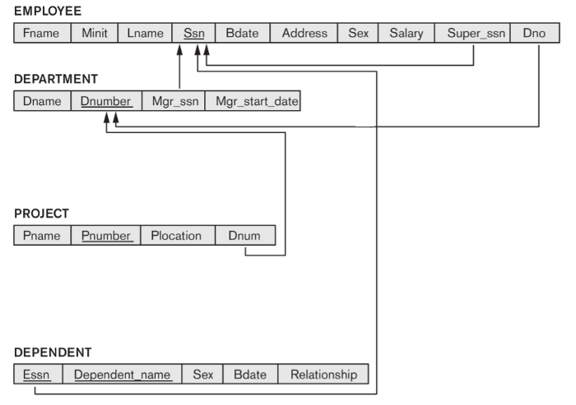

Slide 27
Step 5:
Now we need to figure out the entities from ER diagram for which there exists an M-to-N relationship.
Create a new relation(table) S.
The primary keys of relations(tables) between which M-to-N relationship exists, are added to the new relation S created, that acts as a foreign key.
Then we,add any simple attributes of the M-to-N relationship to S.
For the given ER-Diagram there exists M-to-N relationship between Employee and Project entity.
The new table Works_On is created for mapping the relationship between Employee and Project relation(table).

Slide 28
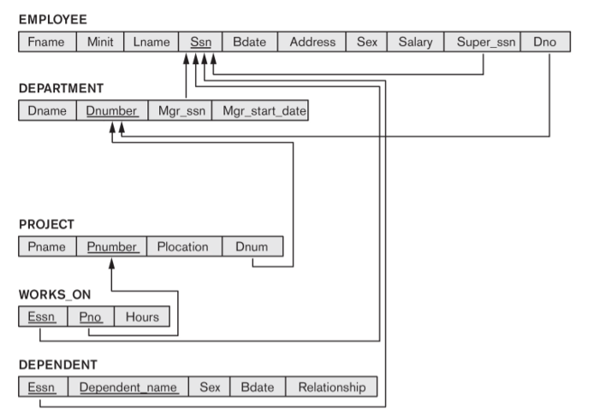

Slide 29
Step 6:
Now identify the relations(tables) that contain multi-valued attributes.
Then we need to create a new relation S
In the new relation S we add as foreign keys the primary keys of the corresponding relation.
Then we add the multi-valued attribute to S; the combination of all attributes in S forms the primary key.
For the given ER-Diagram there exists a multi-valued attribute (Locations) in Department relation(table).
So, we create a new relation called Dept_Locations. To this new relation we add the primary key of Department Table that is D_Number and the multi-valued attribute Locations.

Slide 30
